Slide 1
Distributed Coincidence Processors on two FPGA boards

Slide 2
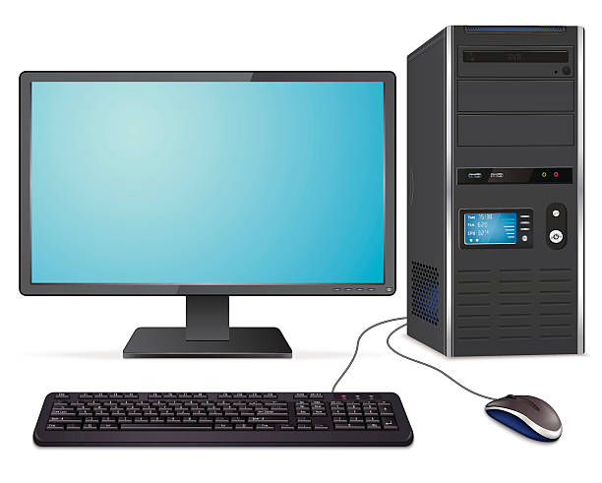
About DCPs in Dual S4 boards
X8
DCP
(X52)
Master
board
Rotating bus
Coincidence event upload interface
Physical
LVDS Interface
Detector
event decode
Clock
event
share
X8
Slave
board
DCP
(X52)
Rotating bus
Coincidence event upload interface
Physical
LVDS Interface
Detector
event decode
Two identical Stratix-4 FPGA boards but one is set as master board to send synchronous clock to slave board
FGPA logic is the same but process different detector channel’s events
16 detectors and 104 DCPs in total. Each board connects to half of the detectors and contains 52 DCPs
Events on individual board will be shared with each other by high-speed transceiver
Each board upload to PC respectively for data processing

Slide 3
Event sharing logic
Master Board
Slave Board
LVDS 0
ch-0 event
Events
Serializer
LVDS 0
ch-0 event
Events
Serializer
LVDS 1
ch-1 event
LVDS 1
ch-1 event
LVDS 2
ch-2 event
LVDS 2
ch-2 event
Mux
8:1
Transceiver
Mux
8:1
Transceiver
LVDS 3
ch-3 event
LVDS 3
ch-3 event
LVDS 4
ch-4 event
LVDS 4
ch-4 event
LVDS 5
ch-5 event
FIFO
LVDS 5
ch-5 event
FIFO
TX
TX
LVDS 6
ch-6 event
LVDS 6
ch-6 event
LVDS 7
ch-7 event
LVDS 7
ch-7 event
PCIE Cable
ch-8 event
Events
De-serializer
ch-8 event
Events
De-serializer
ch-9 event
Data Align-ment
RX
ch-9 event
Data Align-ment
RX
ch-10 event
ch-10 event
ch-11 event
De-
Mux
1:8
ch-11 event
De-
Mux
1:8
ch-12 event
ch-12 event
ch-13 event
FIFO
Basic X4 mode -- 4 lanes
Totally 10Gbps -- 2.5 Gbps X4
128 bits width -- 32 X 4
ch-13 event
FIFO
ch-14 event
ch-14 event
ch-15 event
ch-15 event
16-ch Events for coincidence in 52 DCPs
16-ch Events for coincidence in 52 DCPs

